Slide 1
+ Suse Stemcell
Abhilash S
㈜크로센트
2019. 04

Slide 2
Agenda
Build openSUSE Openstack Stemcell
Deploying Micro-Bosh on openSUSE Stemcell
Deploying CF on Ubuntu Stemcell
Deployment Architecture
CF on openSUSE Stemcell
Deploying CF on openSUSE & Ubuntu Stemcell’s
Note: openSUSE Stemcell only supports on Openstack IaaS only.

Slide 3

1. Build openSUSE Openstack Stemcell (1/3)
Prerequisite
* UAA
* CreduHub
* CF-CLI
* Docker
* Ruby-2.3
* Bosh-CLI
* Go-Language
Build Image and Run Docker Container
1) Building Image
$ cd ~/workspace
$ git clone https://gitlab.com/abhisr/suse-openstack-stemcell.git
$ cd ci/docker/suse-os-image-stemcell-builder
$ ./build
Output:

Slide 4
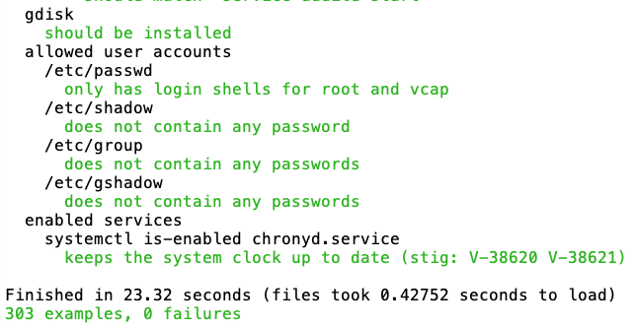
1. Build openSUSE Openstack Stemcell (2/3)
Build Image and Run Docker Container
2) Running Container
$ cd ~/workspace/suse-openstack-stemcell/ci/docker/
$ chmod 755 run
$ ./run suse-os-image-stemcell-builder
Building openSUSE Openstack Stemcell
1) Building openSUSE base image
$ export SKIP_UID_CHECK=1
$ mkdir -p /opt/bosh/tmp
$ bundle exec rake stemcell:build_os_image[opensuse,leap,/opt/bosh/tmp/os_leap_base_image.tgz]
Output:

Slide 5
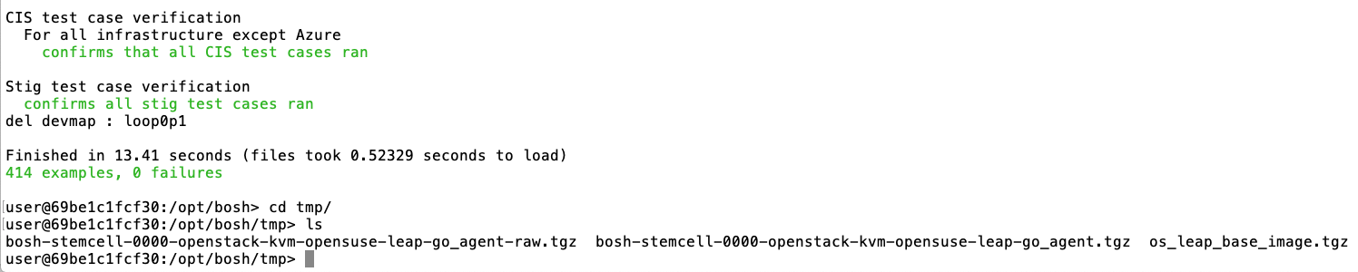
1. Build openSUSE Openstack Stemcell (3/3)
Building openSUSE Openstack Stemcell
1) Building openSUSE Openstack Stemcell
$ export BOSH_MICRO_ENABLED=no
$ bundle exec rake stemcell:build_with_local_os_image[openstack,kvm,opensuse,leap,/opt/bosh/tmp/os_leap_base_image.tgz]
Output:
Copy openSUSE Openstack Stemcell from container to your localhost (NoteBook)
$ docker cp your-contaier-id:/opt/bosh/tmp/bosh-stemcell-0000-openstack-kvm-opensuse-leap-go_agent.tgz your-local-hostpath/bosh-stemcell-0000-openstack-kvm-opensuse-leap-go_agent.tgz
Note: Copy Openstack Stemcell Raw format, only if your Openstack use Ceph Storage instead of cinder
$ docker cp your-contaier-id:/opt/bosh/tmp/bosh-stemcell-0000-openstack-kvm-opensuse-leap-go_agent.tgz your-local-hostpath/bosh-stemcell-0000-openstack-kvm-opensuse-leap-go_agent-raw.tgz

Slide 6
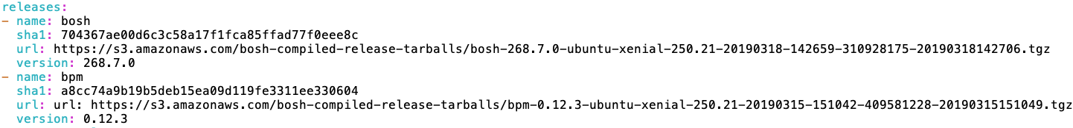
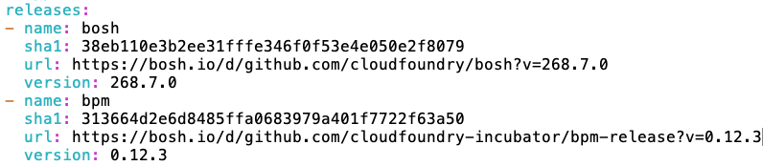
2. Deploying Micro-Bosh on openSUSE Stemcell (1/3)
Prerequisite
Note: Remove Ubuntu Pre-Compiled bosh-releases and add non compiled bosh-release in below yaml files
$ cd ~/workspace
$ git clone https://github.com/cloudfoundry/bosh-deployment.git
$ vi bosh.yaml
$ vi uaa.yml
$ vi credhub.yml
Before
After
Note: You can find bosh, uaa, credhub, bpm non compiled bosh releases in this link bosh-releases.

Slide 7
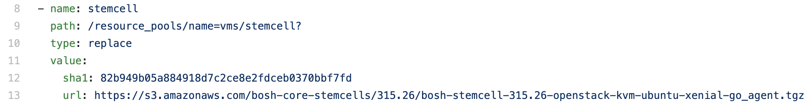
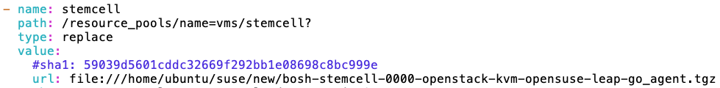
2. Deploying Micro-Bosh on openSUSE Stemcell (2/3)
Prerequisite
Note: Remove Ubuntu stemcell, and add opesnsuse stemcell in below files which is copied from docker container.
$ vi openstack/cpi.yml
Before
After

Slide 8
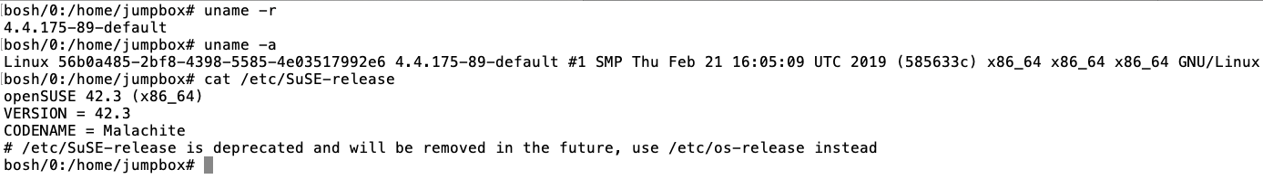
2. Deploying Micro-Bosh on openSUSE Stemcell (3/3)
Note: Follow this link deploy Micro-Bosh on Openstack (Micro-Bosh) .
After deploying Micro-Bosh, check the Micro-Bosh VM filesystem.
Output

Slide 9
3. Deploying CF on Ubuntu Stemcell (1/2)
Note: Target your Bosh-Director
Note Update Openstack cloud-config according your IaaS setting
Upload OpenSatck Stemcell
$ bosh upload-stemcell --sha1 d79a7bc1df3152941e0fa16345a6088c1d1f372e https://bosh.io/d/stemcells/bosh-openstack-kvm-ubuntu-xenial-go_agent?v=250.17
Deploy Cloud Foundry
bosh -e paxpt -d cf deploy /home/ubuntu/suse/cf-deployment/cf-deployment.yml \
-o /home/ubuntu/workspace/cf-deployment/operations/openstack.yml \
-o /home/ubuntu/workspace/cf-deployment/operations/use-haproxy.yml \
-o /home/ubuntu/workspace/cf-deployment/operations/use-haproxy-public-network.yml \
-o /home/ubuntu/workspace/cf-deployment/operations/scale-to-one-az.yml \
-v haproxy_public_network_name=your-public-network-name \
-v haproxy_public_ip=your-floating-ip \
-v system_domain=your-floating-ip.xip.io \

Slide 10
3. Deploying CF on Ubuntu Stemcell (2/2)
Target CF
$ cf login -a https://api.your-floating-ip.xip.io -u admin -p your-cf_admin_password --skip-ssl-validation
Deploy APP in Cloud Foundry
$ cd ~/workspace && git clone https://github.com/cloudfoundry-samples/cf-sample-app-nodejs.git
$ cd cf-sample-app-nodejs.git
$ cf push

Slide 11
4. Deployment Architecture
CF-Core-Engine
Micro-Bosh-VM
Deployment VM
openSUSE OS
Stemcell
Ubuntu Xenial OS
Stemcell
Openstack IaaS
Note: openSUSE Stemcell only supports on Openstack IaaS only.

Slide 12
5. CF on openSUSE Stemcell
Note: If you want to deploy CF on openSUSE Stemcell we have customize Buildpacks, linuxfilesystem (cflinuxfs), Garden-Runc and Bosh-Releases.

Slide 13
6. Deploying CF on openSUSE & Ubuntu Stemcell’s
Download Opensuse Stemcell from PaaS-TA Fileserver: //192.168.0.2\OpenPaaS\2단계 자료(2017~2019)\3차년도/suse
Upload OpenSatck OpenSUSE Stemcell
$ bosh -e pasta upload-stemcell stemcell/bosh-stemcell-0000-openstack-kvm-opensuse-leap-go_agent.tgz
Upload OpenSatck OpenSUSE Stemcell RAW format only if your OpenSatck use CEPH as a storage service (Volume)
$ bosh -e pasta upload-stemcell stemcell/bosh-stemcell-0000-openstack-kvm-opensuse-leap-go_agent-raw.tgz
Note: Deploying CF on openSUSE, Ubuntu Stemcell’s is experimental, not recommended for production.

Slide 14
THANK YOU

